Slide 1
Data Structures Lab
Lab Session # 3

Slide 2
Topics
Ordered Array vs Unordered Array.
Safe Array / Dynamic Safe array.
Ordered DSA / Unordered DSA
Jagged Array.

Slide 3
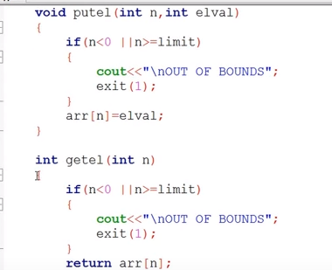
Safe array

Slide 4
Ordered array

Slide 5
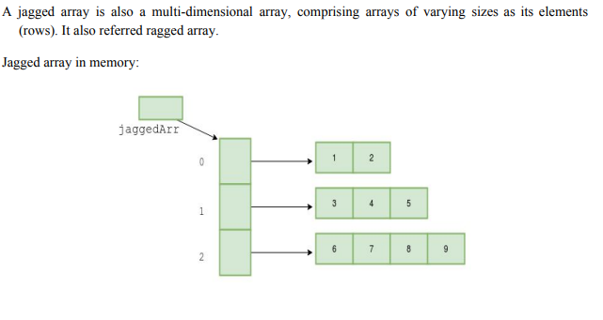
Jagged array

Slide 6
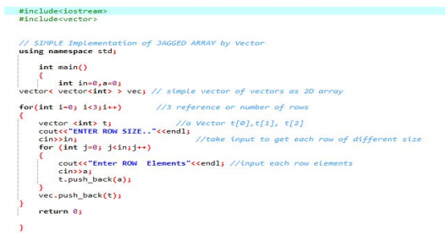

Slide 7
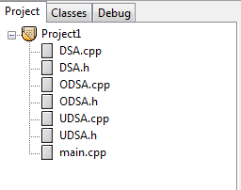
How to attempt Q1

Slide 8
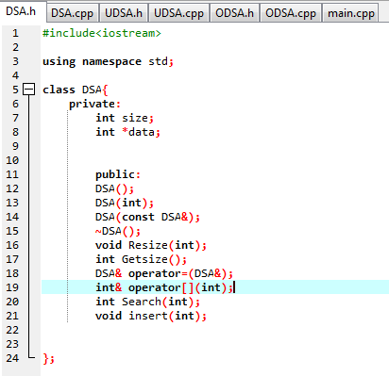
Dynamic Safe Array

Slide 9
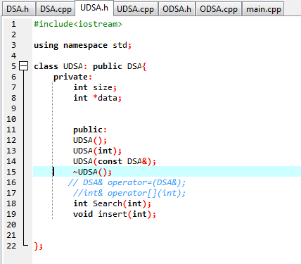
Unordered Dynamic Safe Array

Slide 10
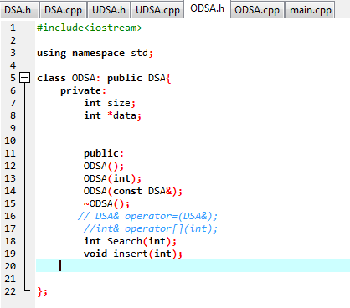
Ordered Dynamic Safe Array

